Slide 1
Heuristic Search
CSE-345: Artificial Intelligence

Slide 2
Heuristic Search
The search techniques we have seen so far...
  Breadth first search
  Uniform cost search
  Depth first search
  Depth limited search
  Iterative Deepening
  Bi-directional Search
...are all too slow for most real world problems
uninformed search
blind search

Slide 3
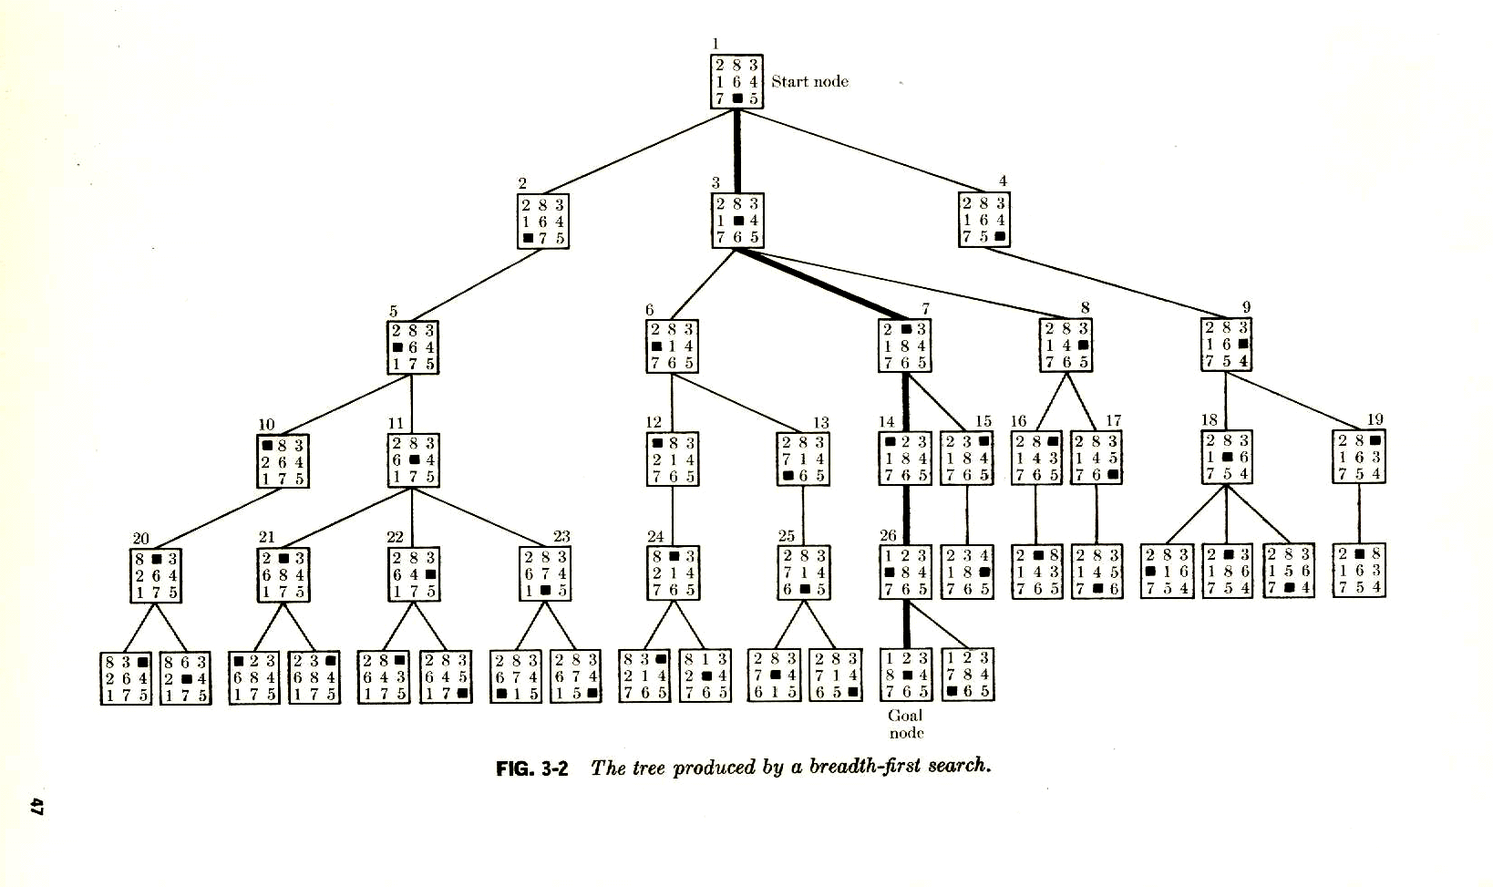
8-Puzzle
Solution in Node 46

Slide 4
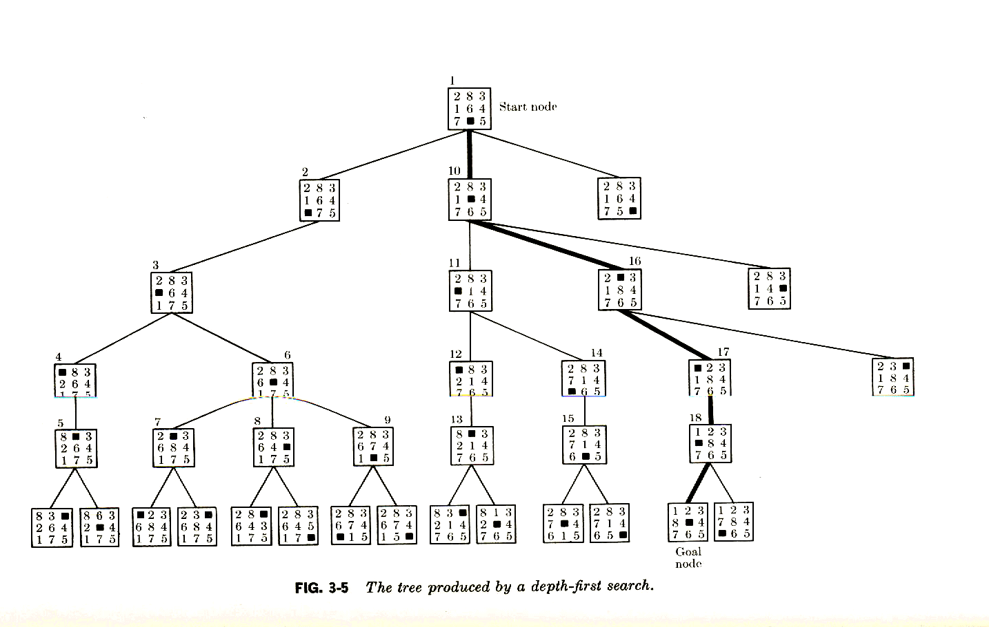
8-Puzzle
Solution in Node 31

Slide 5
Sometimes we can tell that some states appear better than others...
7
8
4
1
2
3
3
5
1
4
5
6
6
2
7
8

Slide 6
...we can use this knowledge of the relative merit of states to guide search
Heuristic Search (informed search)
A Heuristic is a function that, when applied to a state, returns a number that is an estimate of the merit of the state, with respect to the goal.
In other words, the heuristic tells us approximately how far the state is from the goal state*.
Note we said “approximately”. Heuristics might underestimate or overestimate the merit of a state. But for reasons which we will see, heuristics that only underestimate are very desirable, and are called admissible.
*I.e Smaller numbers are better

Slide 7
Heuristics for 8-puzzle I
1
2
3
Current State
4
5
6
7
8
1
2
3
The number of misplaced tiles (not including the blank)
1
2
3
4
5
6
4
5
6
1
2
3
7
8
Goal State
7
8
4
5
6
7
8
N
N
N
In this case, only “8” is misplaced, so the heuristic function evaluates to 1.
In other words, the heuristic is telling us, that it thinks a solution might be available in just 1 more move.
N
N
N
N
Y
Notation: h(n) h(current state) = 1

Slide 8
Heuristics for 8-puzzle II
3
2
8
3
3
Current State
2 spaces
4
5
6
7
1
The Manhattan Distance (not including the blank)
8
1
2
3
Goal State
3 spaces
4
5
6
8
7
8
1
In this case, only the “3”, “8” and “1” tiles are misplaced, by 2, 3, and 3 squares respectively, so the heuristic function evaluates to 8.
In other words, the heuristic is telling us, that it thinks a solution is available in just 8 more moves.
3 spaces
1
Total 8
Notation: h(n) h(current state) = 8

Slide 9
h(n)
1
2
3
5
4
8
7
6
5
1
2
1
2
3
4
8
3
6
4
8
5
4
7
6
5
7
6
We can use heuristics to guide search.
In this example, the Manhattan Distance heuristic helps us quickly find a solution to the 8-puzzle.
1
2
3
3
4
8
5
7
6
1
2
3
1
2
3
4
8
5
4
4
5
2
7
6
7
8
6
1
2
3
1
1
2
3
3
1
3
4
5
4
5
4
2
5
3
7
8
6
7
8
6
7
8
6
goal
1
2
3
0
1
2
4
5
6
4
5
3
2
7
8
7
8
6

Slide 10
Heuristic Search
Heuristic
  heuriskein (Greek word)-to discover
  original: eureka
    -heurika (I have found): Archimedes uttering when determining the purity of gold
Heuristic Function
  a way to inform the search about the direction to a goal.
  provides an informed way to guess which neighbor of a node will lead to a goal.
Pros
  Like a tour guide
  Good to the extent that they point in generally interesting direction
  Improve the quality of the paths that are explored
  Using good heuristic, we can hope to get good solutions to hard problem
  It is possible to construct special-purpose heuristics that exploit domain-specific knowledge to solve particular problems

Slide 11
Heuristic Search
A heuristic is a method that
  -might not always find the best solution
  -but is guaranteed to find a good solution in reasonable time.
By sacrificing completeness it increases efficiency.
Useful in solving tough problems which
  could not be solved any other way.
  solutions take an infinite time or very long time to compute.
The classic example of heuristic search methods is the travelling salesman problem.

Slide 12
Heuristic Search
Traveling Salesman Problem
  Arbitrarily select a starting city
  To select the next city, look at all cities not yet visited,
      -Select the one closest to the current city.
      -Go to it next
  3. Repeat step 2 until all cities have been visited

Slide 13
Heuristic Function
A heuristic function is a function that maps from problem state descriptions to measure of desirability, usually represented as numbers
  -Which aspects of the problem state are considered?
  -How those aspects are evaluated?
  -The weights given to individual aspects are chosen in such a way that the value of the heuristic function at a given node in the search process gives as good an estimate as possible of whether that node is on the desired path to a solution
Well-designed heuristic functions can play an important part in efficiently guiding a search process toward a solution
The purpose of a heuristic function is to guide the search process in the most profitable direction by suggesting which path to follow first when more than one is available
The more accurately the heuristic function estimates the true merits of each node in the search tree/graph, the more direct the solution process

Slide 14
Heuristic Search
Generate –and- test
Hill Climbing
  Simple Hill Climbing
  Steepest-Ascent Hill Climbing
  Simulated Annealing
Best-First Search
  OR Graphs
  A* Algorithm
  Greedy Best-First Search
Problem Reduction
  AND-OR Graphs
  AO* Algorithm
Constraint Satisfaction
Means-ends Analysis

Slide 15
Generate-and-Test
Algorithm
Generate a possible solution.
Test to see if this is actually a solution.
Quit if a solution has been found.
Otherwise, return to step 1.
Acceptable for simple problems.
Inefficient for problems with large space.

Slide 16
Hill Climbing
A variant of generate-and-test in which feedback from the test procedure is used to help the generator decide which direction to move in the search space.
Searching for a goal state = Climbing to the top of a hill
Generate-and-test + direction to move.
Heuristic function to estimate how close a given state is to a goal state.

Slide 17
Simple Hill Climbing
Algorithm
Evaluate the initial state.
Loop until a solution is found or there are no new operators left to be applied:
− Select and apply a new operator
− Evaluate the new state:
goal → quit
better than current state → new current state

Slide 18
Steepest-Ascent Hill Climbing (Gradient Search)
Considers all the moves from the current state.
Selects the best one as the next state.

Slide 19
Steepest-Ascent Hill Climbing (Gradient Search)
Algorithm
Evaluate the initial state.
Loop until a solution is found or a complete iteration produces no change to current state:
− SUCC = a state such that any possible successor of the
current state will be better than SUCC (the worst state).
− For each operator that applies to the current state, evaluate
the new state:
goal → quit
better than SUCC → set SUCC to this state
− SUCC is better than the current state → set the current
state to SUCC.

Slide 20
Hill Climbing: Disadvantages
Local maximum
A state that is better than all of its neighbours, but not better than some other states far away.

Slide 21
Hill Climbing: Disadvantages
Plateau
A flat area of the search space in which all neighbouring states have the same value.

Slide 22
Hill Climbing: Disadvantages
Ridge
The orientation of the high region, compared to the set
of available moves, makes it impossible to climb up.
However, two moves executed serially may increase
the height.

Slide 23
Hill Climbing: Disadvantages
Ways Out
Backtrack to some earlier node and try going in a different direction.
Make a big jump to try to get in a new section.
Moving in several directions at once.

Slide 24
Hill Climbing: Disadvantages
Hill climbing is a local method:
Decides what to do next by looking only at the “immediate” consequences of its choices.
Global information might be encoded in heuristic functions.

Slide 25
Hill Climbing: Disadvantages
Start
A
Goal
D
D
C
C
B
B
A
Blocks World

Slide 26
Hill Climbing: Disadvantages
Start
A
Goal
D
0
4
D
C
C
B
B
A
Blocks World
Local heuristic:
+1 for each block that is resting on the thing it is supposed to be resting on.
−1 for each block that is resting on a wrong thing.

Slide 27
Hill Climbing: Disadvantages
0
A
2
D
D
C
C
B
B
A

Slide 28
Hill Climbing: Disadvantages
2
D
C
B
A
A
0
0
D
C
C
D
C
0
B
B
A
B
A
D

Slide 29
Hill Climbing: Disadvantages
Start
A
Goal
D
−6
6
D
C
C
B
B
A
Blocks World
Global heuristic:
For each block that has the correct support structure: +1 to every block in the support structure.
For each block that has a wrong support structure: −1 to
every block in the support structure.

Slide 30
Hill Climbing: Disadvantages
D
−3
C
B
A
A
−6
−2
D
C
C
D
C
−1
B
B
A
B
A
D

Slide 31
Hill Climbing: Conclusion
Can be very inefficient in a large, rough problem space.
Global heuristic may have to pay for computational complexity.
Often useful when combined with other methods.

Slide 32
Simulated Annealing
A variation of hill climbing in which, at the beginning of the process, some downhill moves may be made.
To do enough exploration of the whole space early on, so that the final solution is relatively insensitive to the starting state.
Lowering the chances of getting caught at a local maximum, or plateau, or a ridge.

Slide 33
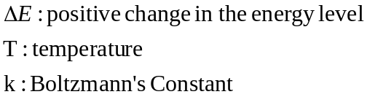
Simulated Annealing
Physical Annealing
Physical substances are melted and then gradually cooled until some solid state is reached.
The goal is to produce a minimal-energy state.
Annealing schedule: if the temperature is lowered sufficiently slowly, then the goal will be attained.
Nevertheless, there is some probability for a transition to a higher energy state: p=e^{−ΔE/kT}.

Slide 34
Simulated Annealing
Algorithm
Evaluate the initial state.
Loop until a solution is found or there are no new operators left to be applied:
− Set T according to an annealing schedule
− Selects and applies a new operator
− Evaluate the new state:
goal → quit
ΔE = Val(current state) − Val(new state)
ΔE < 0 → new current state
else → new current state with probability e^{−ΔE/kT}.

Slide 35
Difference from Simple Hill Climbing
Annealing schedule must be maintained
Moves to worse states may be accepted
It is a good idea to maintain, current state, the best state found so far.
Then, if the final state is worse than that earlier state, the earlier state is still available

Slide 36
Best-First Search
A way of Combining the advantage of both DFS and BFS into a single method.

Slide 37
Best-First Search: OR Graphs
Depth-first search: not all competing branches having to be expanded.
Breadth-first search: not getting trapped on dead-end paths.
⇒ Combining the two is to follow a single path at a time, but switch paths whenever some competing path look more promising than the current one.

Slide 38
Best-First Search: OR Graphs
A
A
A
B
C
D
B
C
D
3
5
1
3
5
E
F
4
6
A
A
B
C
D
B
C
D
5
5
G
H
E
F
G
H
E
F
6
5
4
6
6
5
6
I
J
2
1
A graph of this sort are called OR graph, since each of its branches represent an alternative problem-solving path.

Slide 39
Best-First Search: OR Graphs
OPEN: nodes that have been generated, but have not examined.
This is organized as a priority queue.
CLOSED: nodes that have already been examined.
Whenever a new node is generated, check whether it has been generated before.

Slide 40
Best-First Search
Algorithm
OPEN = {initial state}.
Loop until a goal is found or there are no nodes left in OPEN:
− Pick the best node in OPEN
− Generate its successors
− For each successor:
new → evaluate it, add it to OPEN, record its parent
generated before → change parent, update successors

Slide 41
Best-First Search
Some authors have used "best-first search" to refer specifically to a search with a heuristic that attempts to predict how close the end of a path is to a solution, so that paths which are judged to be closer to a solution are extended first.
This specific type of search is called greedy best-first search
Special cases:
  greedy best-first search
  A* search

Slide 42
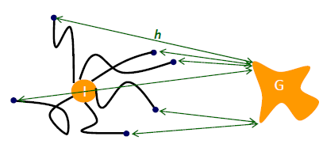
Greedy Best-First Search
Evaluation function f(n) = h(n) (heuristic)
= estimate of cost from n to goal
Greedy best-first search expands the node that appears to be closest to goal
e.g., hSLD(n) = straight-line distance from n to Bucharest
Goal state
initial state

Slide 43
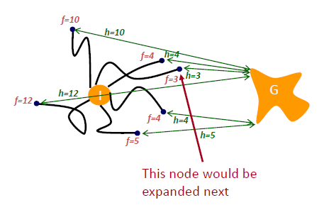
Greedy Best-First Search
f(n) = h(n) : Expand node that appears to be closest to the goal

Slide 44
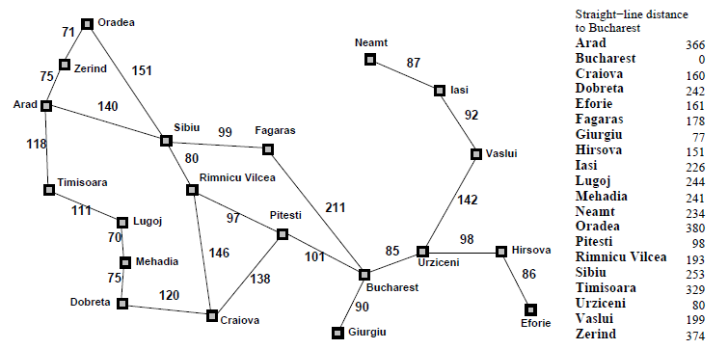
Greedy Best‐First Tree Search Example
Go from Arad to Bucharest
f(n) = h_{SLD}(n) = straight‐line distance from n STATE to Bucharest
h (n)
SLD
234

Slide 45

Greedy Best‐First Tree Search Example
h (n)

Slide 46
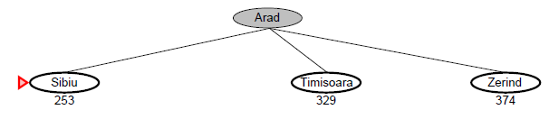
Greedy Best‐First Tree Search Example
h (n)

Slide 47
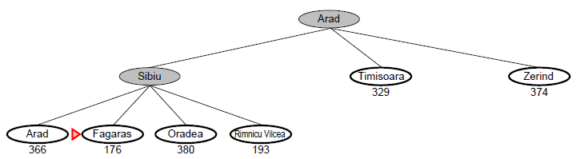
Greedy Best‐First Tree Search Example
h (n)
h=176
h=193

Slide 48
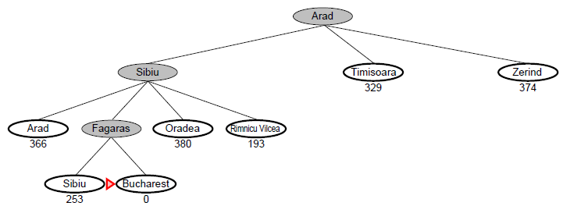
Example
h (n)

Slide 49
Solution turns out not to be optimal
Optimal solution

Slide 50
Properties of greedy best-first search
Complete? No – can get stuck in loops, e.g., Iasi → Neamt → Iasi → Neamt →
Time? O(b^{m}), but a good heuristic can give dramatic improvement
Space? O(b^{m}) -- keeps all nodes in memory
Optimal? No
Complete in finite space with repeated-state checking

Slide 51
Greedy Best-First Search
Greedy search:
h(n) = estimated cost of the cheapest path from node n to a goal state.
Neither optimal nor complete
Uniform-cost search:
g(n) = cost of the cheapest path from the initial state to node n.
Optimal and complete, but very inefficient

Slide 52
A* search
Idea: avoid expanding paths that are already expensive
include cost of reaching node
Evaluation function f(n) = g(n) + h(n)
-g(n) = cost of reaching n
-h(n) = estimated cost of reaching goal from state of n
-f(n) = estimated cost of the cheapest path to a goal state that goes through path of n

Slide 53
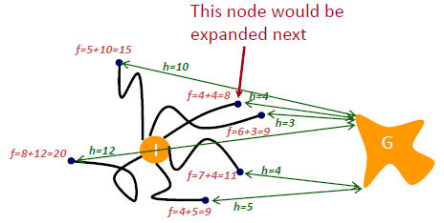
A* Search
f(n) = g(n) + h(n) : Expand node that appears to be on cheapest paths to the goal

Slide 54
A* search example
Go from Arad to Bucharest
f(n) = g(n) + h_{SLD}(n)

Slide 55


A* search example
h(n)

Slide 56
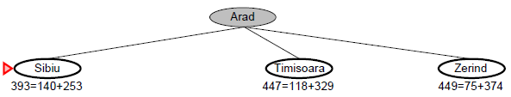
A* search example
h(n)

Slide 57
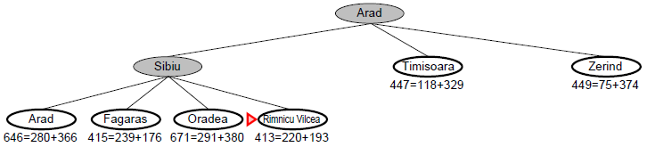
A* search example
h(n)

Slide 58
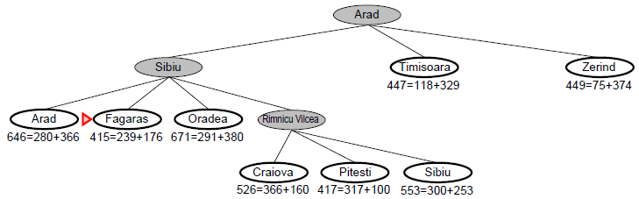
h(n)

Slide 59
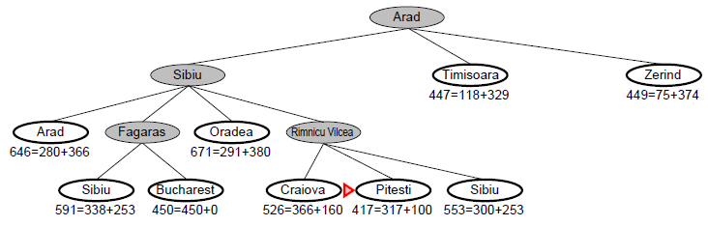
h(n)

Slide 60
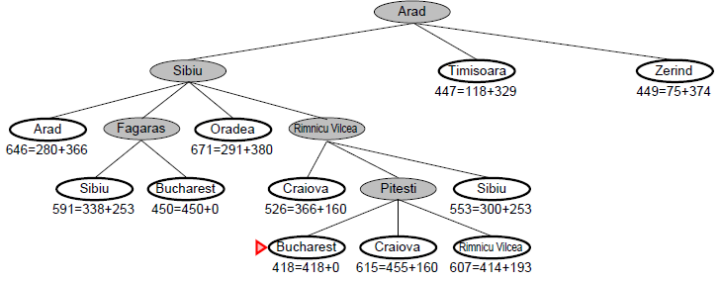
Solution is optimal!
is this a coincidence?
No, when h(n) underestimates the cost
of reaching a goal, A* (tree search) is optimal

Slide 61
Admissible heuristic
Let h*(N) be the true cost of the optimal path from N to a goal node
Heuristic h(N) is admissible if:
0 ≤ h(N) ≤ h*(N)
An admissible heuristic is always optimistic

Slide 62
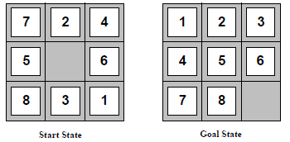
Admissible heuristics
For the 8-puzzle: If we want to find the shortest solutions, we need a heuristic function that never overestimates the number of steps to the goal. Here are two candidates:
h₁(n) = number of misplaced tiles
h₂(n) = total Manhattan distance (no. of squares from desired location of each tile)
h1(S) =??
h2(S) =??
h1(S) =?? 6
h2(S) =?? 4+0+3+3+1+0+2+1 = 14

Slide 63

Optimality of A* (proof)
Suppose some suboptimal goal G₂ has been generated and is in the fringe. Let n be an unexpanded node in the fringe such that n is on a shortest path to an optimal goal G.
  f(G₂) = g(G₂) since h(G₂) = 0
  g(G₂) > g(G) since G₂ is suboptimal
  f(G) = g(G) since h(G) = 0
  f(G₂) > f(G) from above

Slide 64
Optimality of A* (proof)
Suppose some suboptimal goal G₂ has been generated and is in the fringe. Let n be an unexpanded node in the fringe such that n is on a shortest path to an optimal goal G.
  f(G₂) > f(G) from above
  h(n) ≤ h*(n) since h is admissible
  g(n) + h(n) ≤ g(n) + h*(n)
  f(n) ≤ f(G)
Hence f(G₂) > f(n), and A* will never select G₂ for expansion

Slide 65
Properties of A
Complete?? Yes, unless there are infinitely many nodes with f ≤ f(G)
Time?? Exponential in [relative error in h x length of soln.]
Space?? Keeps all nodes in memory
Optimal?? Yes-cannot expand f_{i+1} until f_{i} is finished
A expands all nodes with f(n) < C*
A expands some nodes with f(n) = C*
A expands no nodes with f(n) > C*

Slide 66

Proof of lemma: Consistency
A heuristic is consistent if
h(n) ≤ c(n,a,n') + h(n')
If h is consistent, we have
f(n') = g(n') + h(n')
= g(n) + c(n,a,n') + h(n')
≥ g(n) + h(n)
≥ f(n)
i.e., f(n) is always greater at a successor node, so once a node has been visited, it cannot be visited again at a smaller cost and thus will never be reopened
Theorem: If h(n) is consistent, A* using GRAPH-SEARCH is optimal

Slide 67
Dominance
If h₂(n) ≥ h₁(n) for all n (both admissible)
then h₂ dominates h₁ and is better for search
For 8-puzzle heuristics h1 and h2 , typical search costs (average number of nodes expanded for solution depth d):
d=12 IDS = 3,644,035 nodes
A*(h₁) = 227 nodes
A*(h₂) = 73 nodes
d=24 IDS = 54,000,000,000 nodes
A*(h₁) = 39,135 nodes
A*(h₂) = 1,641 nodes

Slide 68
Relaxed Problems
A problem with fewer restrictions on the actions is called a relaxed problem
The cost of an optimal solution to a relaxed problem is an admissible heuristic for the original problem
Admissible heuristics can be derived from the exact solution cost of a relaxed version of the problem
Example:
If the rules of the 8-puzzle are relaxed so that a tile can move anywhere, then h₁(n) gives the shortest solution
If the rules are relaxed so that a tile can move to any adjacent square, then h₂(n) gives the shortest solution
Key point: the optimal solution cost of a relaxed problem is no greater than the optimal solution cost of the real problem

Slide 69
Problem Reduction
Goal: Acquire TV set
Goal: Steal TV set
Goal: Earn some money
Goal: Buy TV set
AND-OR Graphs
Algorithm AO* (Martelli & Montanari 1973, Nilsson 1980)

Slide 70
AND-OR Graph
Most promising single node: G (f`=3)
Arc: G-H (7+2=9)
But that arc is not part of the current best path since to use it, we must also use the arc: I-J (27)
Path A-B-E-F is better (5+10+2+1=18)
Should not expand G next; rather should examine either E/F
A
(38)
B
C
D
(17)
(9)
(27)
E
F
G
H
I
J
(5)
(10)
(3)
(4)
(15)
(10)

Slide 71
Problem Reduction
Initialize the graph to the starting node
Loop until the starting node is labeled SOLVED or until its cost goes above FUTILITY
(a) Traverse the graph, starting at the initial node & following the current best path, & accumulate the set of nodes that are on that path & have not yet been expanded/labeled as solved
(b) Pick one of these unexpanded nodes & expand it. if there are no successors, assign FUTILITY as the value of this node. Otherwise, add its successors to the graph & for each of them compute f` (use only h` & ignore g). If f` of any node is 0, mark that node as SOLVED
(c) Change the f` estimate of the newly expanded node to reflect the new info provided by its successors
-propagate this change backward through the graph
-if any node contains a successor are whose descendants are all solved, label the node itself as SOLVED
-at each node that is visited while going up the graph, decide which of its successor arcs is the most promising & mark it as part of the current best path
This may cause the current best path to change
This propagation of revised cost estimates back up the tree was not necessary in the BFS algo because only unexpanded nodes were examined
But now expanded nodes must be reexamined so that the best current path can be selected
Thus it is important that their f` value estimates available

Slide 72
Problem Reduction(Example)
A
A
6
5
9
B
C
D
3
4
5
A
9
A
11
9
12
B
C
D
10
B
6
C
D
10
3
4
4
E
F
G
H
E
F
4
4
5
7
4
4

Slide 73
Problem Reduction: Limitation
A
A
B
C
D
B
C
D
E
F
G
H
E
F
G
H
Unsolvable
Unsolvable
I
J
I
J
-suppose J is expanded at the next step
-that one of its successors in node E
Long path may be better
-This new path to E is longer than the previous path to E going through C
-but since the path through C will only lead to a solution if there is also a solution to D, which we Know there is not, the path through J is better

Slide 74
Problem Reduction: Limitation
Fails to take into account any interaction between sub goals
Both node C/E ultimately lead to a solution, algorithm will report a complete solution that includes both of them
AND-OR graph states that for A to be solved, both C/D must be solved
The algo considers the solution of D as a completely separate process from the solution of C
Looking just at the alternatives from D, E is the best path
But it turns out that C is necessary anyway, so it would be better also to use it to satisfy D
But the algo does not consider such interactions, it will find a non-optimal path.
A
D
C
(5)
E
(2)

Slide 75
AO* Algorithm
Algorithm for searching AND-OR graph is called AO*
Here single structure G, representing the part of the search graph that has been explicitly generated so far is used rather than two lists, OPEN and CLOSED in previous algorithms.
Each node in the graph will point both down to its immediate successors and up to its immediate predecessor.
Each node in a graph will also have associated with it an h value (an estimate of the cost of a path from current node to a set of solution nodes).
We will not store g (cost from start to current node) as it is not possible to compute a single such value since there may be many paths to the same state.
Also such value is not necessary because of the topdown traversing of the best-known path which guarantees that only nodes that are on the best path will ever be considered for expansion. So h will be good estimate for AND/OR graph search.

Slide 76
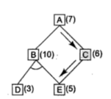
AO* Algorithm (Example)
Unnecessary backward propagation

Slide 77
AO* Algorithm (Example)
A
11
A
14
B
13
C
10
B
13
C
15
D
5
E
6
F
3
D
5
E
6
F
3
G
5
G
10
Necessary backward propagation
H
9

Slide 78
Constraints Satisfaction Problem (CSP)
Standard search problem:
  state is a "black box“ – any data structure that supports successor function, heuristic function, and goal test
CSP:
  state is defined by variables X_{i} with values from domain D_{i}
  goal test is a set of constraints specifying allowable combinations of values for subsets of variables
Simple example of a formal representation language
Allows useful general-purpose algorithms with more power than standard search algorithms

Slide 79

Example: Map-Coloring
Variables WA, NT, Q, NSW, V, SA, T
Domains D_{i} = {red,green,blue}
Constraints: adjacent regions must have different colors
e.g., WA ≠ NT, or (WA,NT) in {(red,green),(red,blue),(green,red), (green,blue),(blue,red),(blue,green)}

Slide 80

Example: Map-Coloring
Solutions are complete and consistent assignments satisfying all constraints,
e.g.,{WA = red, NT = green, Q = red, NSW = green, V = red,
SA = blue, T = green}

Slide 81

Constraint graph
Binary CSP: each constraint relates at most two variables
Constraint graph: nodes are variables, arcs show constraints

Slide 82
Varieties of CSPs
Discrete variables
  finite domains:
    n variables, domain size d → O(d^{n}) complete assignments
    e.g., Boolean CSPs, incl.~Boolean satisfiability (NP-complete)
  infinite domains:
    integers, strings, etc.
    e.g., job scheduling, variables are start/end days for each job
    need a constraint language, e.g., StartJob₁ + 5 ≤ StartJob₃
Continuous variables
  e.g., start/end times for Hubble Telescope observations
  linear constraints solvable in poly time by LP methods

Slide 83
Varieties of CSPs
Unary constraints involve a single variable,
SA ≠ green
Binary constraints involve pairs of variables,
SA ≠ WA
Higher-order constraints involve 3 or more variables,
cryptarithmetic column constraints
Preferences (soft constraints), e.g., red is better than green
-often representable by a cost for each variable assignment→ constrained optimization problems

Slide 84
Constraint Satisfaction
As compared with a straightforward search procedure, viewing a problem as one of constraint satisfaction can reduce substantially the amount of search.

Slide 85
Constraint Satisfaction
Operates in a space of constraint sets.
Initial state contains the original constraints given in the problem.
A goal state is any state that has been constrained “enough”.

Slide 86
Constraint Satisfaction
Two-step process:
1. Constraints are discovered and propagated as far as possible.
2. If there is still not a solution, then search begins, adding new constraints.

Slide 87
Constraint Satisfaction
Two kinds of rules:
1. Rules that define valid constraint propagation.
2. Rules that suggest guesses when necessary.

Slide 88
Constraint Satisfaction
Many AI problems can be viewed as problems of constraint satisfaction.
Cryptarithmetic puzzle:
SEND
MORE
MONEY
+

Slide 89
Initial state:
No two letters have
the same value.
The sum of the digits
must be as shown.
M = 1
S = 8 or 9
O = 0
N = E + 1
C2 = 1
N + R > 8
E ≠ 9
SEND
MORE
MONEY
+
Initial state of problem.
D=?
E=?
Y=?
N=?
R=?
O=?
S=?
M=?
C1=?
C2=?
C1 ,C 2, C3 stands for the carry variables respectively.
Goal State: the digits to the letters must be assigned in such a manner so that the sum is satisfied.
E = 2
N = 3
R = 8 or 9
2 + D = Y or 2 + D = 10 + Y
C1 = 1
C1 = 0
2 + D = Y
N + R = 10 + E
R = 9
S =8
2 + D = 10 + Y
D = 8 + Y
D = 8 or 9
D = 8
D = 9
Y = 0
Y = 1
Conflict
Conflict

Slide 90
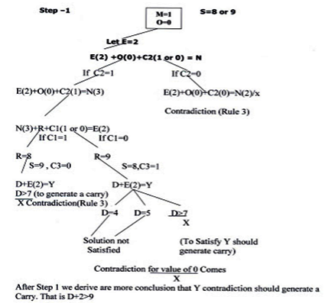

Slide 91
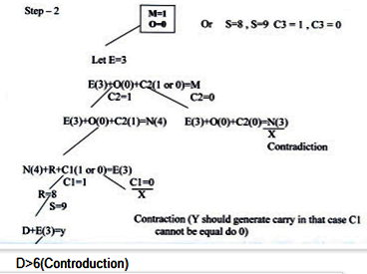

Slide 92
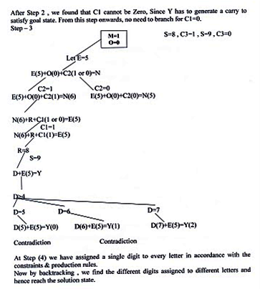

Slide 93

Solution!!!
Y= 2
D=7
S=9
R=8
N=6
E=5
O=0
M=1
C1=1
C2=0
C3=0
C3 (0) C2 (1) C1 (1)
S (9) E (5) N (6) D (7)
+ M (1) O (0) R (8) E (5)
--------------------------------------------------------
M (1) O (0) N (6) E (5) Y (2)

Slide 94
Assignment
Why not best-first search algorithm is not adequate for searching AND-OR graphs?

Slide 95
More Cryptarithmetic Problem
BLACK 7 9 2 0 8
GREEN 5 3 4 4 6
------------ ----------------
ORANGE 1 3 2 6 5 4
CRASH 3 6 8 4 5
HACKER 5 8 3 9 2 6
------------ -------------------
REBOOT 6 2 0 7 7 1
CROSS 9 6 2 3 3
ROADS 6 2 5 1 3
------------ ----------------
DANGER 1 5 8 7 4 6

